Slide 1

Shearon Farms Single Family Homeowners Association Meeting
Tuesday, December 03, 2013
7:00 pm @ Richland Creek Community Church

Slide 2
Agenda
Introductions
Review of 2013 SF SF HOA Activities
Review of 2013 Budget
Review of proposed 2014 Budget & vote to ratify
Meeting wrap-up

Slide 3
Introductions
Shearon Farms SF HOA Board of Directors
  President: Harvey Ridder
  VP President: Tom Paonessa
  Treasurer: Open Position
  Secretary: Ed Kato
  Board Member-at-large: Kathy Kennell

Slide 4
Review of 2013 SF SF HOA Activities
Street sign installation project (7) signs installed
Spring HOA event 5/18
  Wake Forest Police Department
  Wake Forest Fire Department
  Neighborhood cookout
Neighborhood luminary project 12/24
Monument maintenance
  Precious Stone Dr.
  Clover Bank St.
Neighborhood yard sale
ShearonFarms.com web site

Slide 5
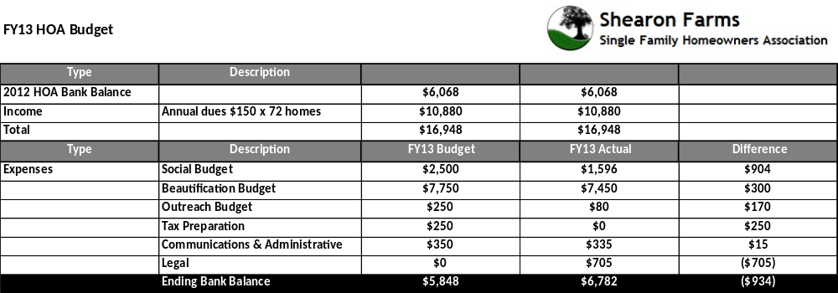
Review of 2013 Budget

Slide 6
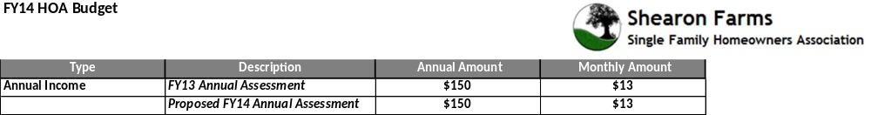
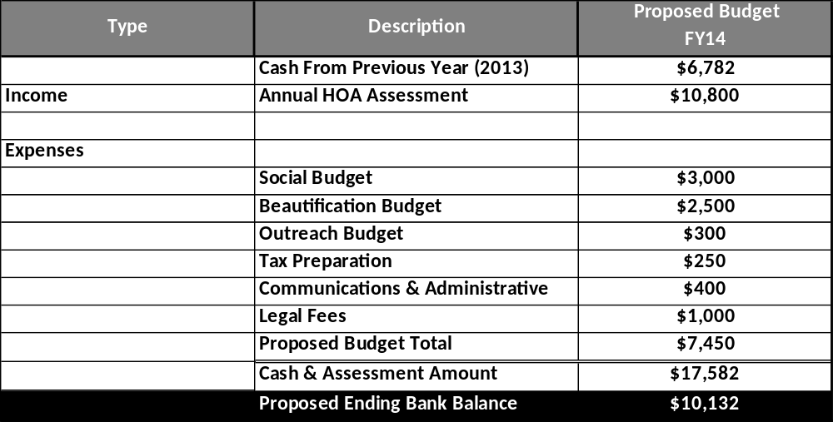
Review of proposed 2014 Budget

Slide 7
Meeting wrap-up
Luminary Captains (2) people from each street, 5 streets = 10 volunteers
  Luminary event, 12/24
Treasurer Board Member opening for 2014
Committee volunteers needed for 2014
  Outreach
  Architectural Review Board
  Community Watch
  Beautification

